Slide 1
STATE-WISE FOREST COVER IN INDIA

Slide 2
“We don’t inherit the Earth from our ancestors - we borrow it from our children.”
Native American Proverb

Slide 3

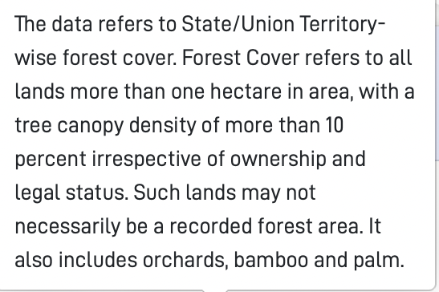
DATA COLLECTION
- How is forest cover defined in this dataset?
- Forest cover data is collected through satellite imagery by Forest Survey of India (FSI)
Algorithms are used to classify captured images (and therefore forests) in appropriate categories

Slide 4
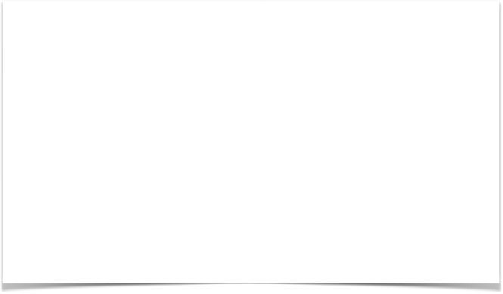
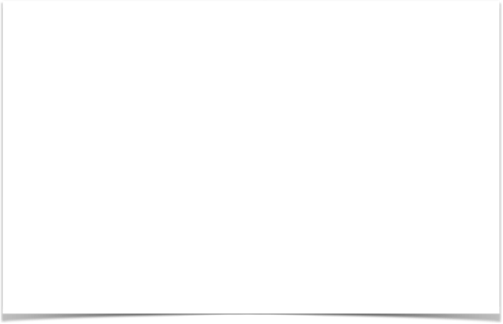
UNDERSTANDING THE VARIABLES
Forest Cover refers to all lands more than one hectare in area, with a tree canopy density of more than 10 percent irrespective of ownership and legal status. Such lands may not necessarily be a recorded forest area
VERY DENSE: All Lands with tree cover of canopy density of 70% and above (in sq. km)
MODERATELY DENSE: All lands with tree cover of canopy density between 40% and 70% above (in sq. km)
OPEN FOREST: All lands with tree cover of canopy density between 10% and 40% (in sq. km)
REAL CHANGE: Change in tree cover between 2009 and 2011
GEOGRAPHICAL AREA: Total geographical area of state
Very Dense Forest Cover
Moderately Dense Cover
Source: https://fsi.nic.in/scheme-of-classification

Slide 5
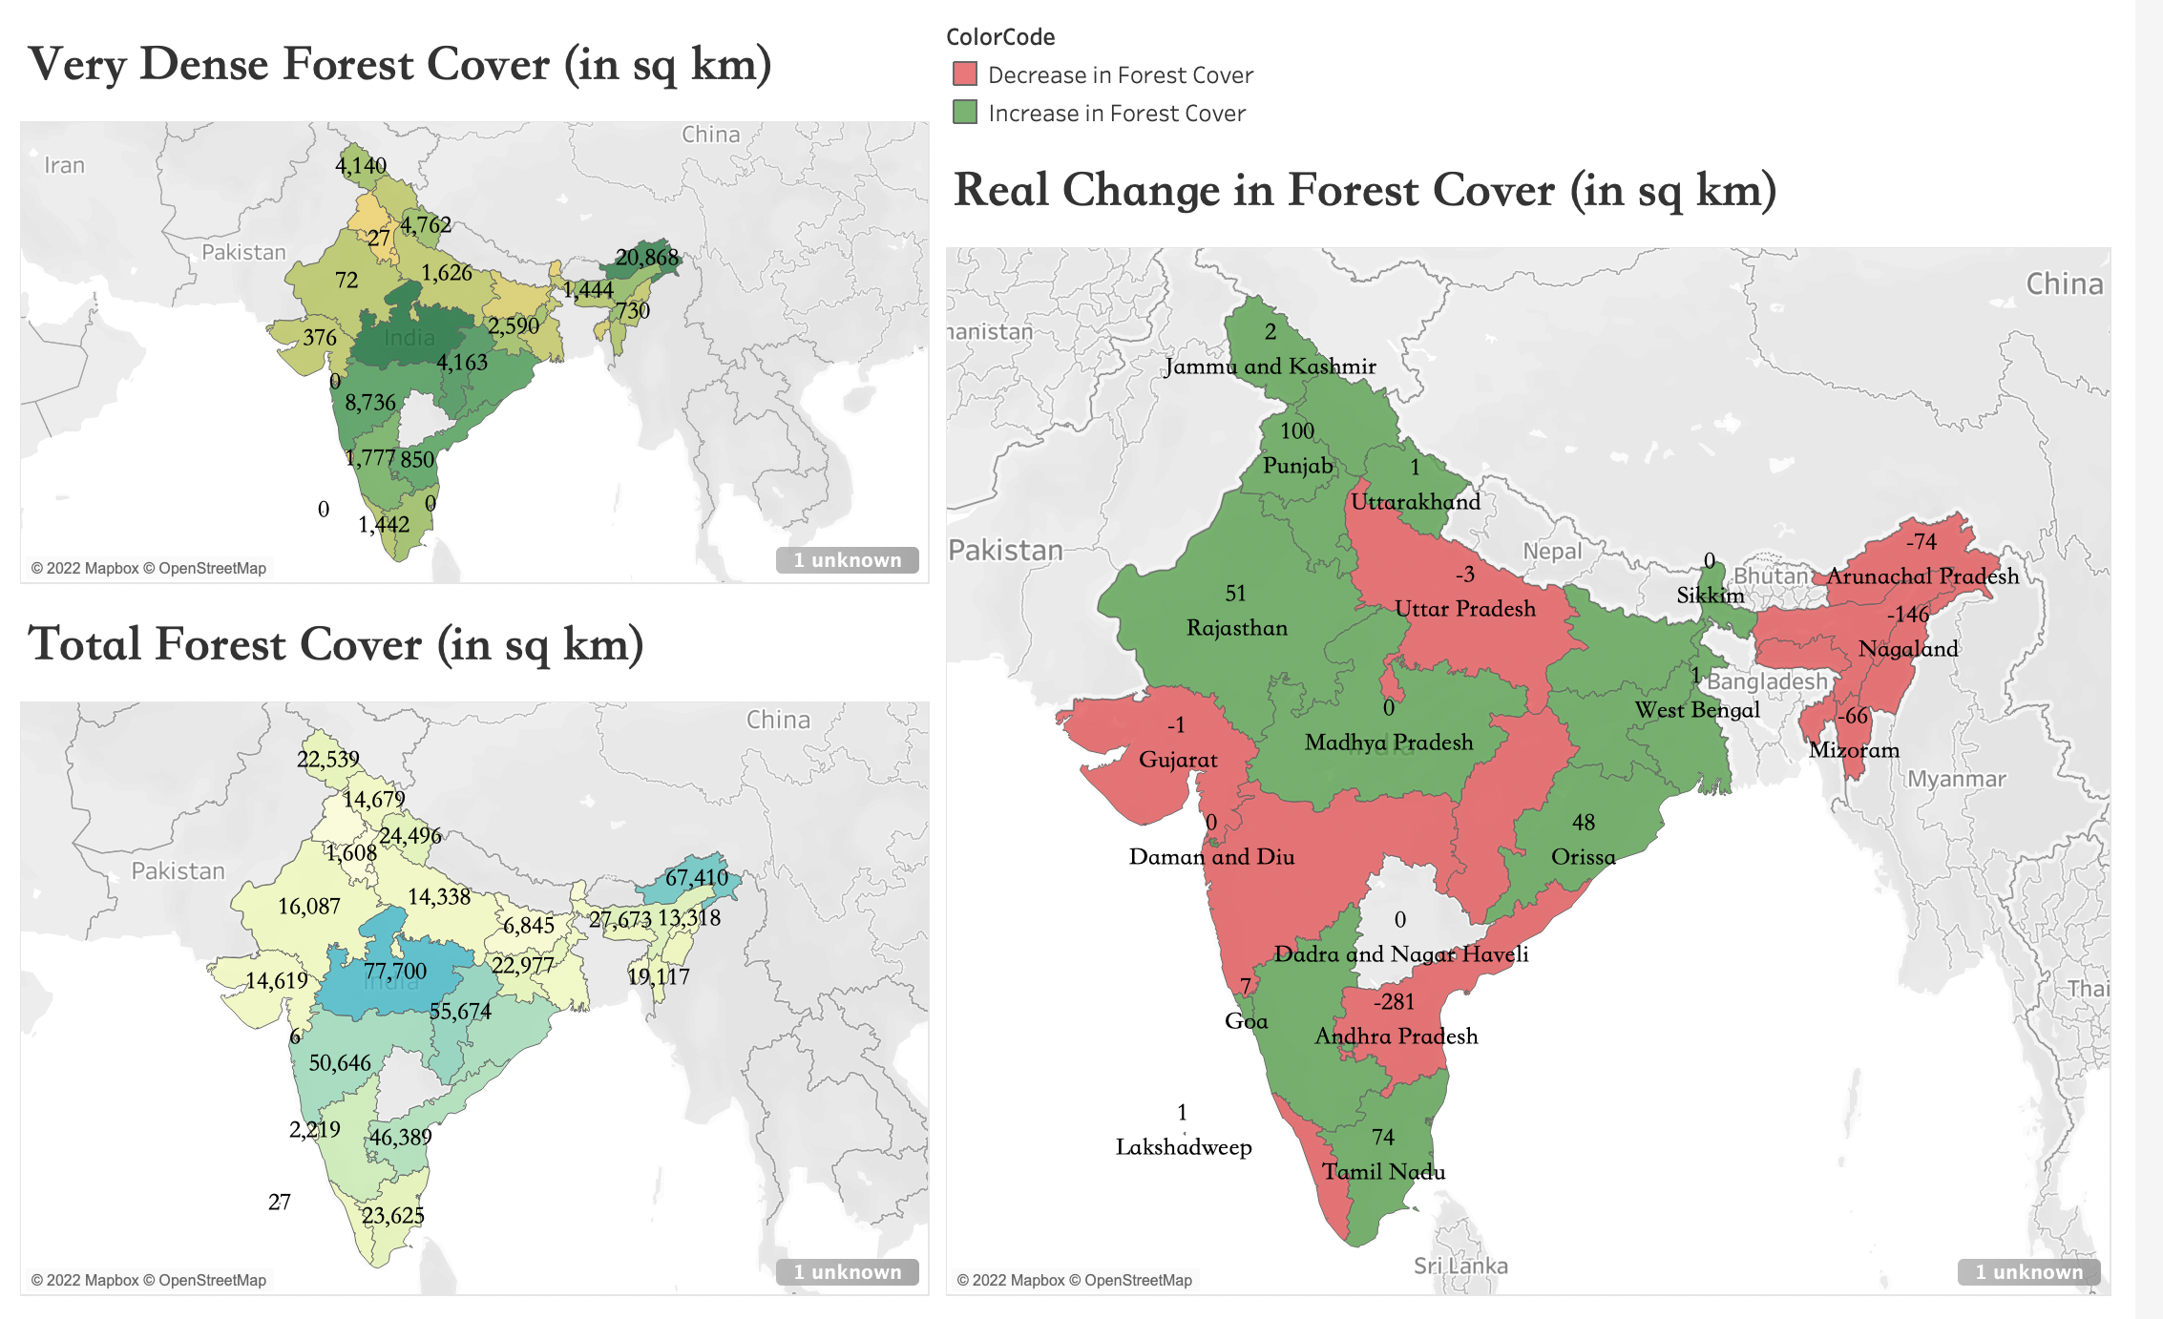
Questions:
Which states have the highest/lowest total forest cover? Deviation?
2. What is the state-wise breakup of forest cover?
In which states have the forest cover increased/decreased the most compared to 2009?

Slide 6
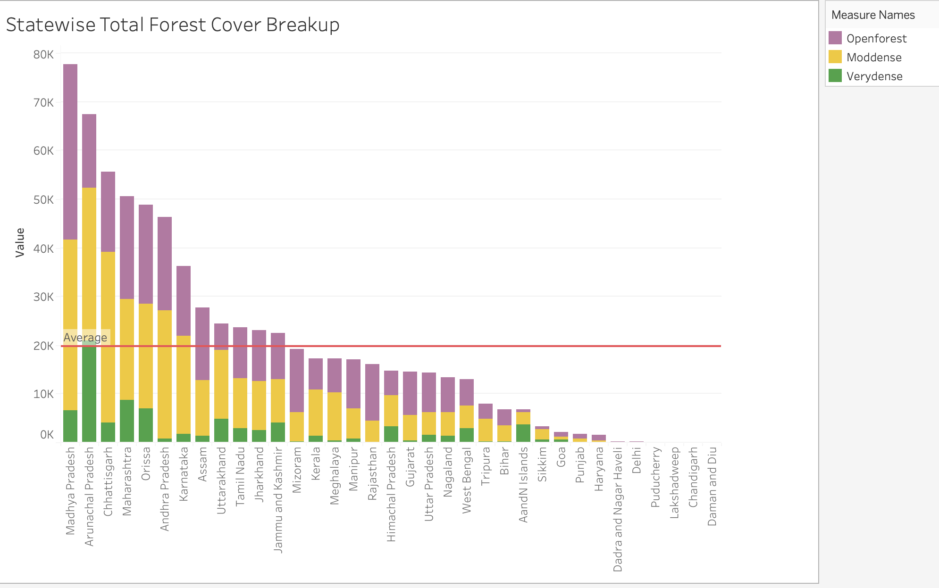
States with highest total forest cover

Slide 7
https://public.tableau.com/app/profile/arav.sood/viz/ForestCover2011/Dashboard1?publish=yes

Slide 8
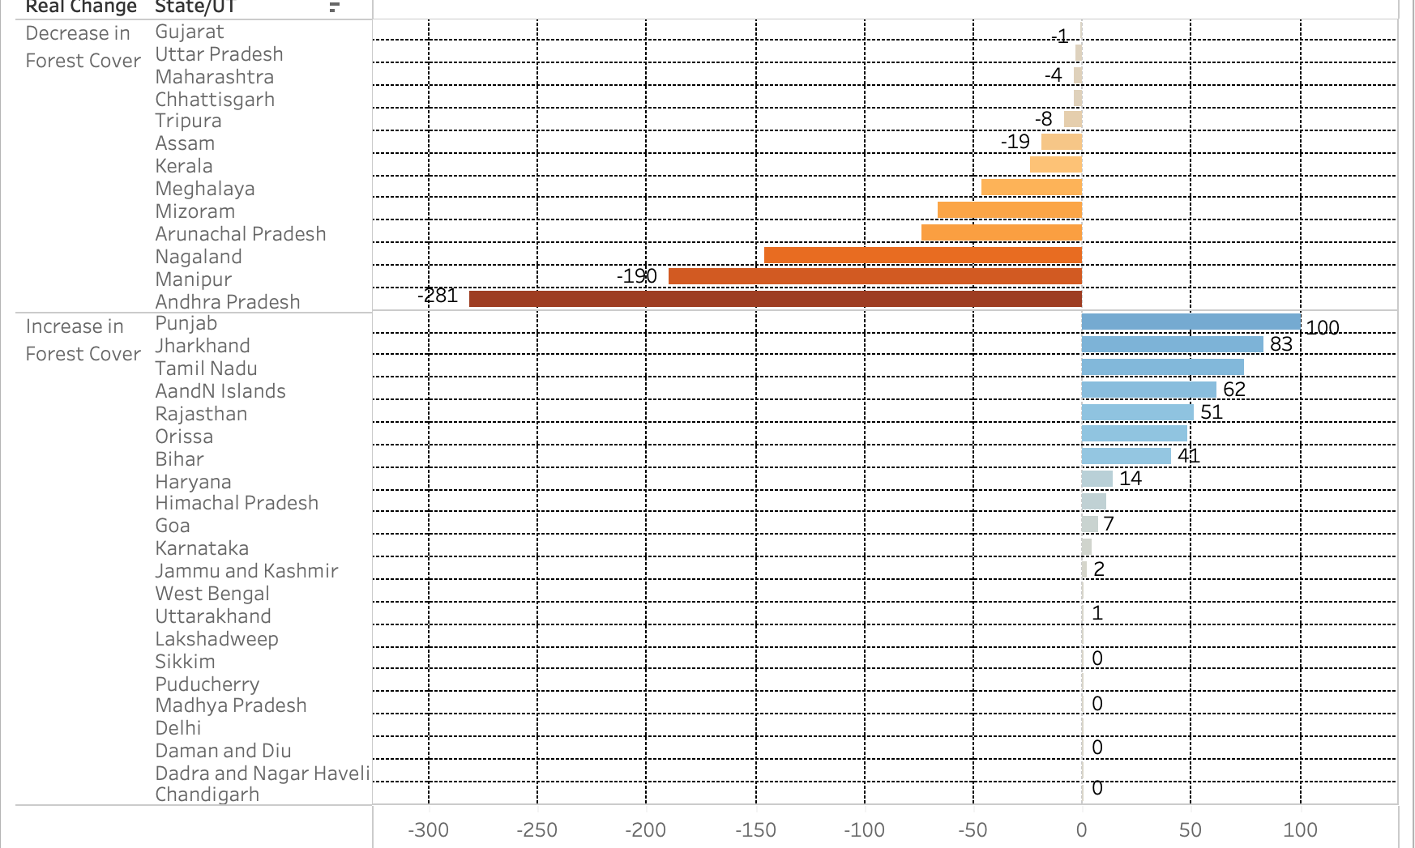
Ordered State-Wise Real Change

Slide 9
HYPOTHESIS TESTING
Gov of India claims that the total forest cover (TFC) of India has increased. However, experts claim that the data has been masked for the purpose of meeting international CO2 benchmarks and to portray the government initiatives in good light. Let’s test the hypothesis that the (real) change in forest cover is less than/equal to zero:
Null: Ho: mu<=0; Alternate: H1: mu> 0 (Right Tailed Test)
Sample average (of change in TFC) = -10.45
Sample s=72.50
n=35
alpha=0.05
Since population SD is unknown, we can use t-distribution. However, n is more than 35, so z-distribution will be used.
Z-critical value=1.645 (95% CI)
Z statistic=-10.45/(72.50/sqrt(35))=-0.852
Since Z statistic is < Z critical value, we do not reject the null hypothesis.
P-value=0.803 is greater than 0.05, therefore, we do not reject the null hypothesis.
Conclusion: Government of India’s claim is questionable.

Slide 10
CONCLUSION
Our Learnings
- More than half of the states have a total forest cover less than the average forest cover
- According to research, FSI has been criticized about the approach with which it measures forest cover, i.e., its decision to include wooded parks, private timber forests, etc.
-Experts claim that India is actually losing its forest cover , disproportionately so in certain states, where there is a policy emphasis on “development”
-Data analysis also involves questioning the source of the data and the legitimacy of the data involved

